Slide 2
Decorator Pattern in Java File Reading
Java's java.io package is the textbook real-world example of the Decorator pattern. Instead of one class trying to do everything (read raw bytes + buffer + handle characters + parse lines), Java wraps simple objects with layers that each add one capability.
BufferedReader reader = new BufferedReader(
new InputStreamReader(
new FileInputStream("data.txt")));
FileInputStream — the core component; just reads raw bytes.
InputStreamReader — decorator that adds byte→character conversion.
BufferedReader — decorator that adds buffering + readLine().
Each wrapper implements the same interface as what it wraps, and adds behavior without touching the original class. That's the whole point of the pattern — open for extension, closed for modification.

Slide 3
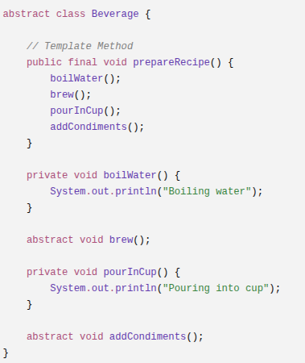
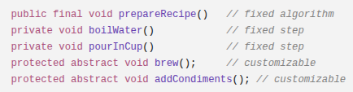
Template Method

Slide 4
Template Method
Standard way

Slide 5
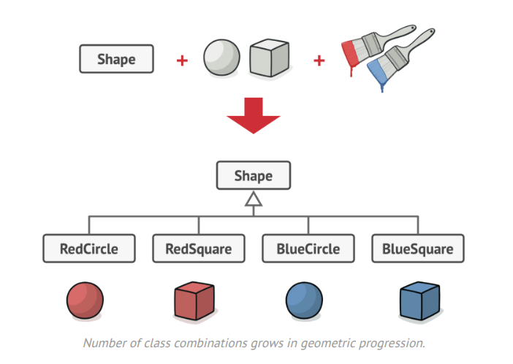
Bridge Pattern

Slide 6
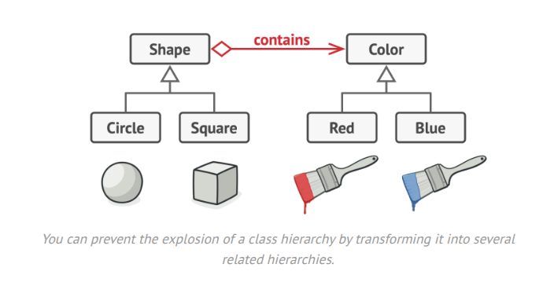
Bridge Pattern

Slide 7

Bridge Pattern
separates an abstraction from its implementation so that both can vary independently.
useful when you have two independent dimensions of variation. Instead of creating subclasses for every combination, you connect the two hierarchies using composition.
Example
Suppose your application can send notifications through different channels.
Abstraction
Alert Notification
Promotion Notification
OTP Notification
Implementation
Email
SMS
Push Notification

Slide 8
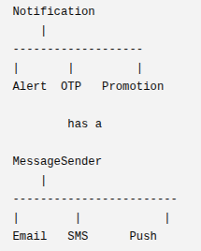
abstract class Notification {
protected MessageSender sender;
Notification(MessageSender sender){
this.sender = sender;
}
abstract void notifyUser();
}
class AlertNotification extends Notification {
AlertNotification(MessageSender sender){
super(sender);
}
void notifyUser(){
sender.send("Server is down!");
}
}
…
With Bridge
interface MessageSender {
void send(String msg);
}
class EmailSender implements MessageSender {
public void send(String msg){
System.out.println("Email: " + msg);
}
}
…..

